Slide 1
The control of mycotoxins in foods & feeds
THE TOXIMET SYSTEM
Prof. Raymond Coker
Raymond Coker Consulting Limited
August 2015

Slide 2
Agenda
The mycotoxin problem
The modern approach to mycotoxin control
Mycotoxin measurement methods
The ToxiMet System

Slide 3
Agenda
The mycotoxin problem
The modern approach to mycotoxin control
Mycotoxin measurement methods
The ToxiMet System

Slide 4
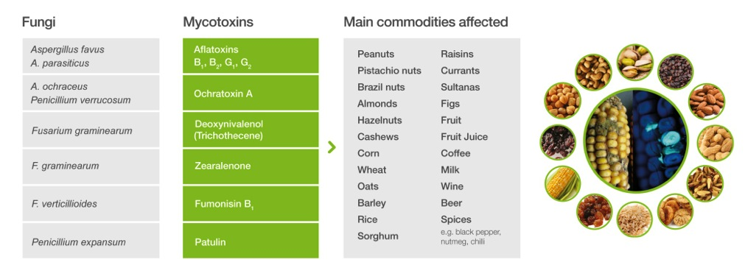
Mycotoxins are highly potent toxins produced by certain fungi, and can contaminate numerous commodities
  FAO estimates that potentially toxigenic fungi are present in 25% of global crops
  Mycotoxins are acutely & chronically toxic, and carcinogenic to animals & Man

Slide 5
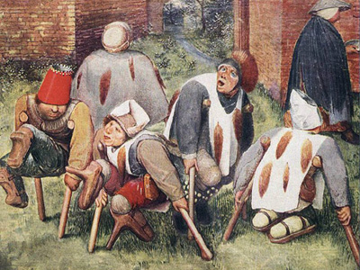
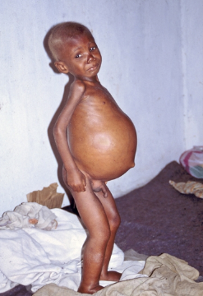
Important Human Mycotoxicoses
Mycotoxin | Toxicity
Ergot alkaloids | St Anthony’s Fire (Europe in Middle Ages) (Hallucinations & loss of limbs) A very early example of a mycotoxicosis
Aflatoxins | Acutely toxic in high concentrations (ppm) Liver disease Malnutrion (Kwashiokor) Stunted growth Liver cancer
Ochratoxin A | Renal disease e.g. “Balkan endemic nephropathy” (but still open to debate!)
Fumonisins | Human oesophageal cancer
Deoxynivalenol | Nausea, vomiting, abdominal pain, diarrhoea
T-2 Toxin | “Alimentary toxic aleukia” (Vomiting, diarrhoea, leukopenia) Killed tens of thousands of people in USSR in 1940s
St Anthony’s Fire
Liver cancer

Slide 6
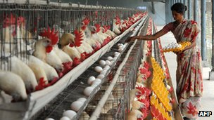
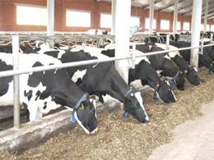
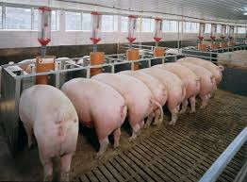
Important Animal Mycotoxicoses
CAUSE SERIOUS FINANCIAL LOSSES
(Aflatoxins, Ochratoxin A, Deoxynivalenol, Zearalenone, Fumonisins)
POULTRY:
Turkey X disease – England, 1960s
Decrease disease resistance (inc. vaccination failure)
Decreased feed conversion ratio
Increased water consumption
Increase bruising of carcass
Decreased egg production
Poor shell quality
Decreased hatchability
DAIRY CATTLE:
Deceased feed consumption
Decreased feed conversion ratio
Decreased milk production
Milk contaminated with aflatoxin M₁, if aflatoxin B1 in diet
SWINE:
Serious reproductive disorders
Notes:
Mycotoxins are acutely & chronically toxic, mutagenic and carcinogenic compounds. The main target for toxicity and carcinogenicity is the liver, causing cancer.
Several outbreaks of Mycotoxicoses occurred since the beginning of organized crop production.
For example:
- St Anthony’s fire was caused by the consumption of rye contaminated with ergot alkaloids (Claviceps purpurea). Two types of symptom – hallucinations & gangrene.
- The development of a Fusarium Toxin (T-2 toxin) in overwintered wheat was responsible for the death of thousands in Siberia during the Second World War. The disease ATA (Alimentary Toxic Aleukia) caused vomiting, acute inflammation of the alimentary tract (pain, swelling, and loss of function of tubular passage) , anaemia, circulatory failure and convulsions (A convulsion is a medical condition where body muscles contract and relax rapidly and repeatedly, resulting in an uncontrolled shaking of the body).
- In the 1960s, about 100,000 turkey poults died near London, England due to peanut meal that was contaminated by the aflatoxins produced by Aspergillus flavus -The Turkey X disease led to more research on mycotoxins.

Slide 7
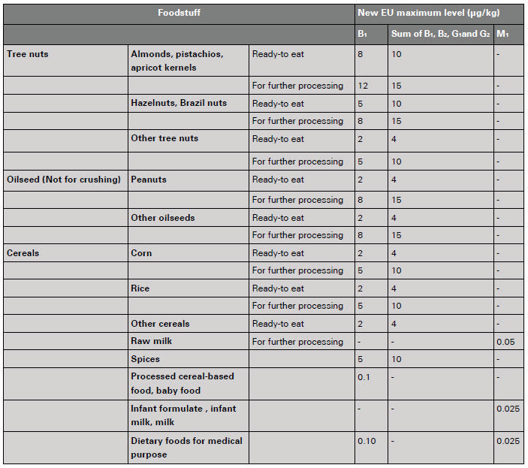
Mycotoxins are highly regulated worldwide and are especially stringent in Europe -
EU Regulations for Mycotoxins in Food
Notes:
Of all mycotoxins regulated worlwide, aflatoxins are the most regulated.

Slide 8
Worldwide Regulations
Regulations have a large impact on trade especially upon the
exports of emerging economies!
USA – FDA action levels (FDA, 2000)
Europe – Legislation for food (EU, 2010b) – especially stringent regulations
Europe – Legislation for animal feed (EU, 2003)
Codex Alimentarius – Global guidelines for acceptable mycotoxin levels
Rest of World – individual countries have their own regulations
Emerging countries especially affected by regulations:
BRIC – Brazil, Russia, India and China
MINT – Mexico, Indonesia, Nigeria, and Turkey
Notes:
Of all mycotoxins regulated worlwide, aflatoxins are the most regulated.

Slide 9
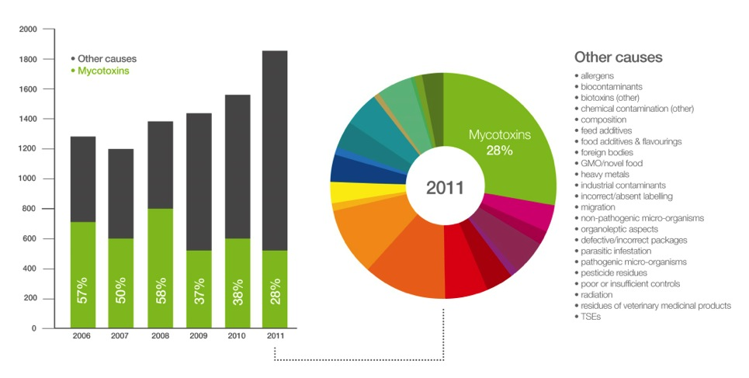
Mycotoxins are a leading cause for EU border rejections

Slide 10

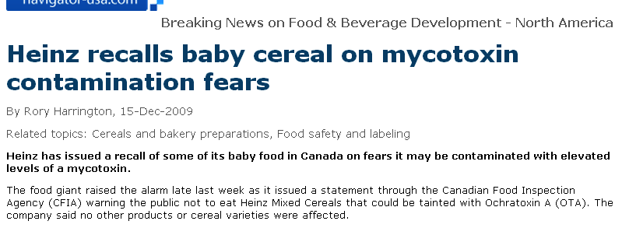
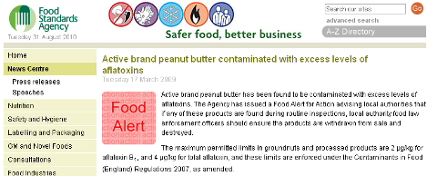
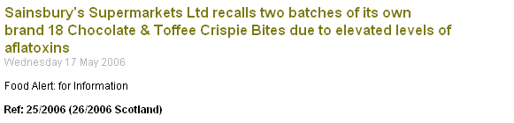
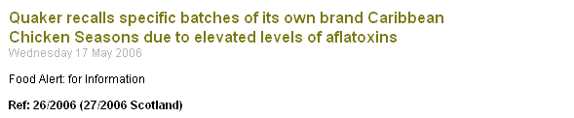


SUPERMARKETS REACT BADLY TO MYCOTOXIN CONTAMINATED PRODUCTS!!
Brand damage
Recall costs
Negative PR
Source: Press search; UK Food Standards Agency; RASFF database

Slide 11


Product rejection, at multiple mycotoxin testing points, leads to highly significant financial losses associated with purchase, processing, sales & transportation costs throughout global food (and feed) value chains:
*
Processors
Traders
START Farmers
Exporter
R
P
Purchasing points
Accurate testing (HPLC) applied by regulators
ACCURATE & UNIFORM TESTING:
Before purchase/processing
During processing
After processing (at export & import)
Shipping
END
Supermarkets (Food)
Livestock farmers (Feed)
R
Importer
Supermarkets exert large amount of pressure on their suppliers in the value chain!
Processors
Traders
Multiple mycotoxin testing points
Some larger farmer will test on-farm
*
Outsource small number of tests
for due diligence purposes

Slide 12
Agenda
The mycotoxin problem
The modern approach to mycotoxin control
Mycotoxin measurement methods
The ToxiMet System

Slide 13
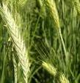
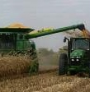

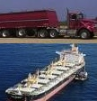


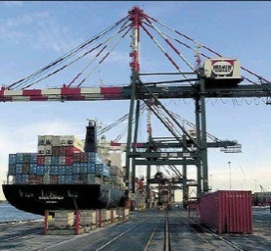
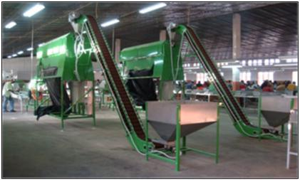
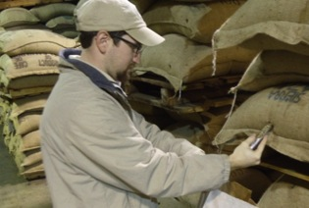
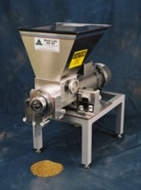
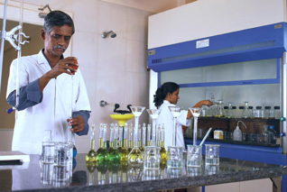
The application of Hazard Analysis & Critical Control Points (HACCP) Plans for mycotoxin control throughout the food & feed value chains:
The mycotoxin content of batches are controlled at Critical Control Points (CCPs) as they pass along the value chain, requiring accurate & convenient sampling, sample preparation & analysis methods
Crop
Harvest
Drying &
Storage
Transport
Border
Control
Processing
Retail
Sampling, sample preparation and analysis accurately performed at CCPs
ANALYSIS SHOULD BE PERFORMED ACCURATELY & CONSISTENTLY!

Slide 14
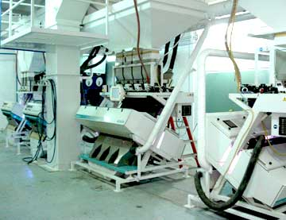
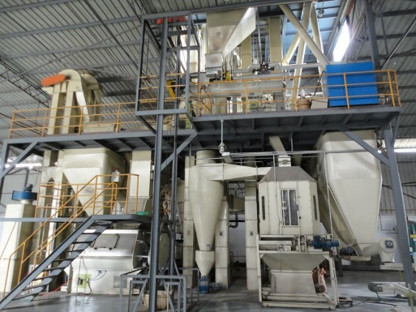
HACCP mycotoxin control methods are frequently employed in food & feed processing plants:
Potential control points (CCPs and Good Manufacturing Practice)
Edible Nut Processing
Feed Manufacturing
At purchasing point of raw material(s)
At factory gate
After cleaning
After shelling
During & after optical sorting and hand picking
After roasting (if appropriate)
At the factory gate
At purchasing point of raw material(s)
At factory gate
After grinding
After mixing
After pelleting
After grading
After bagging
At factory gate

Slide 15
Analysis methods employed at Critical Control Points should have the following criteria:
High performance: Highly accurate, simultaneous analysis of multiple mycotoxins (matching performance of HPLC)
Highly consistency: Same performance throughout the value chain
Simple & robust: Operated by non-scientists in factory and warehouse environments, at high ambient temperatures
Faster turnaround: Whole analysis completed in 45min. or less
Environmentally friendly: Low solvent usage
Lower health risks to employees: Factory calibrated; no need for users to handle toxins whilst producing calibration curves
Lower maintenance costs: e.g. minimal number of moving parts

Slide 16
Agenda
The mycotoxin problem
The modern approach to mycotoxin control
Mycotoxin measurement methods
The ToxiMet System

Slide 17
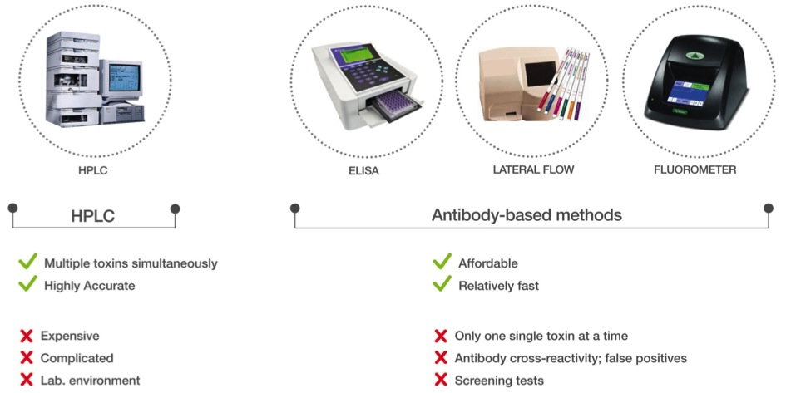
Several mycotoxin testing methods currently exist, but all have serious drawbacks when employed within a HACCP Plan

Slide 18
Agenda
The mycotoxin problem
The modern approach to mycotoxin control
Mycotoxin measurement methods
The ToxiMet System

Slide 19


Slide 20




We believe that safe & nutritious food should be accessible to everyone in the world
ToxiMet founded in 2005 by mycotoxin control specialist Professor Raymond Coker
Prof. Raymond Coker
Emeritus Professor of Food Safety at the University of Greenwich
Has worked in global control of mycotoxins in food & feed for almost 40 years.
  led many international projects on behalf of FSA, FAO, WHO, EU, IAEA, USAID & DFID
  operated in South & South East Asia, China, Africa & South America
  specialist in development of sampling, sample preparation & analysis methods; design & implementation of HACCP Plans; design and construction of chemical detoxification technology
Developed the ToxiMet System in response to his identification of a clear need for mycotoxin analysis methods which could be employed in a variety of different locations within food and feed value chains, during the implementation of HACCP Plans

Slide 21
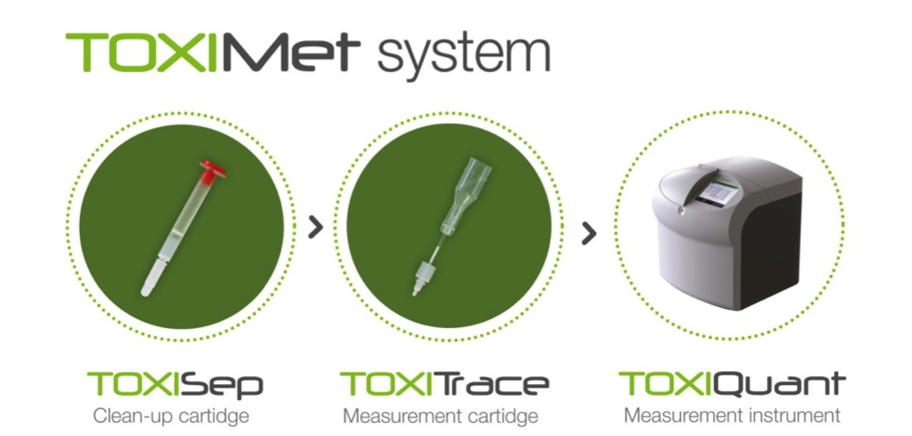
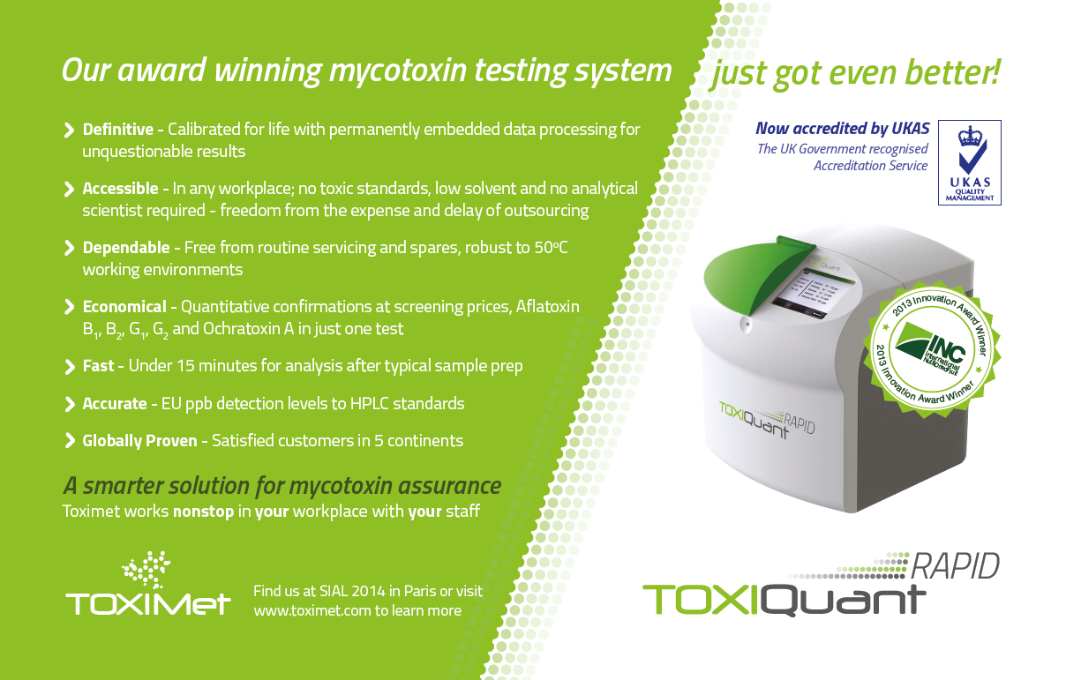
Affordable & robust
Multiple toxins, simultaneously
Used by non-scientists
Highly accurate
Fast & no calibration
Minimal maintenance

Slide 22
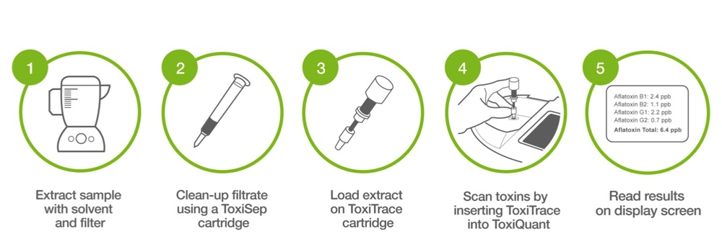
ToxiMet System: extraction to highly accurate, quantitative results in just 45 minutes
All methods: 30 min.
ToxiMet System: 15min.

Slide 23
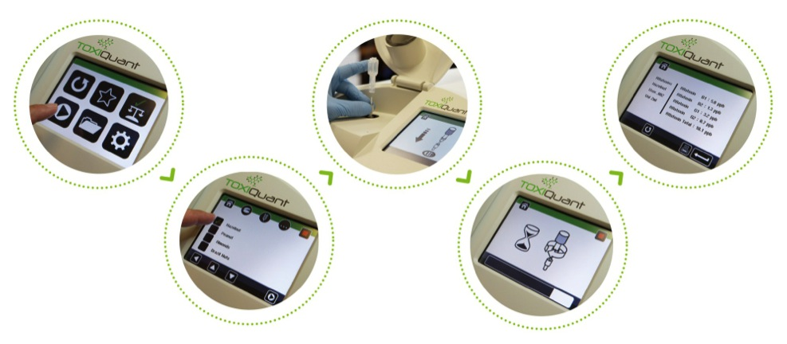
ToxiQuant instrument touch-screen interface designed for easy operation by non-scientists and with no opportunity for interfering with integrity of results

Slide 24
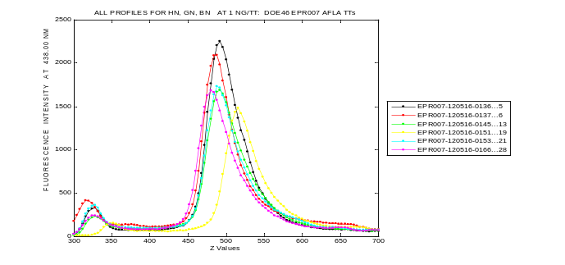
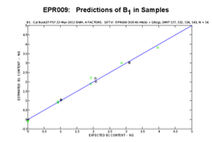
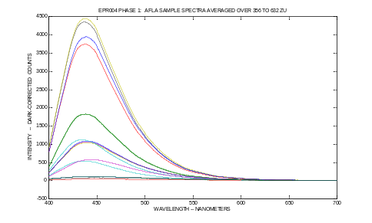
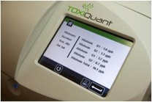
Innovative combination of sophisticated spectroscopy and chemometric software allows simultaneous and accurate multiple toxin measurement
Fluorescence
signals
Fluorescence
spectra
Chemometric
predictions
Results
displayed
Sophisticated optical system enables the generation of an accurate and precise fluorescence signal by a mixture of toxins immobilised on the ToxiTrace cartridge
The fluorescence signal is converted into a mixed fluorescence spectrum by a mini-spectrometer incorporated within the ToxiQuant instrument
The mixed spectrum is interrogated by a sophisticated proprietary chemometric algorithm which recognises and accurately quantifies the individual immobilised toxins
Expensive & complex chromatographic separation & measurement (HPLC) replaced by affordable & simple “mathematical” separation & measurement process

Slide 25









The ToxiQuant instrument combines the best properties of current testing methods, and can be successfully operated in factories & warehouses throughout the globe
ELISA
Lateral Flow
Fluorometer
HPLC
UPLC
LC-MS/MS
Affordable
Fast
Simultaneous multiple toxins
Highly accurate
Highly accurate
Multiple toxins measured, simultaneously
Affordable & robust
Fast & no calibration required
Minimal maintenance

Slide 26

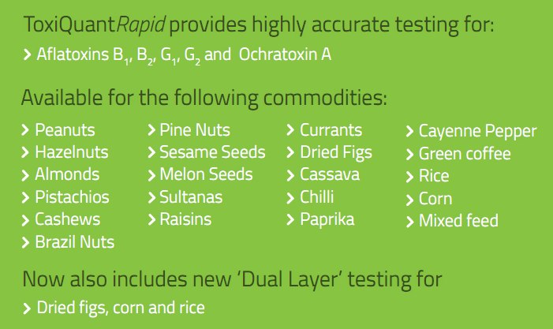

Slide 27
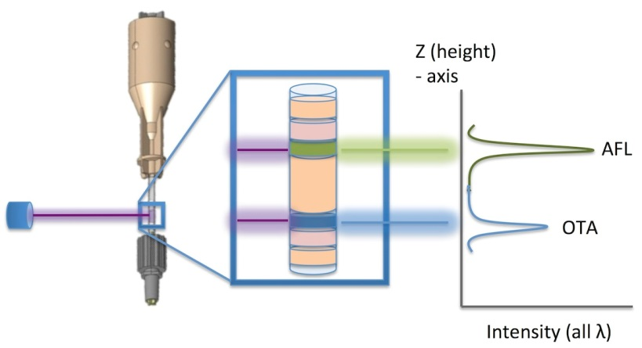
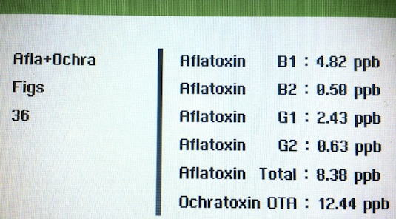
Dual layer ToxiTrace plus ToxiQuant instrument simultaneously immobilises & measures aflatoxins and ochratoxin A

Slide 28
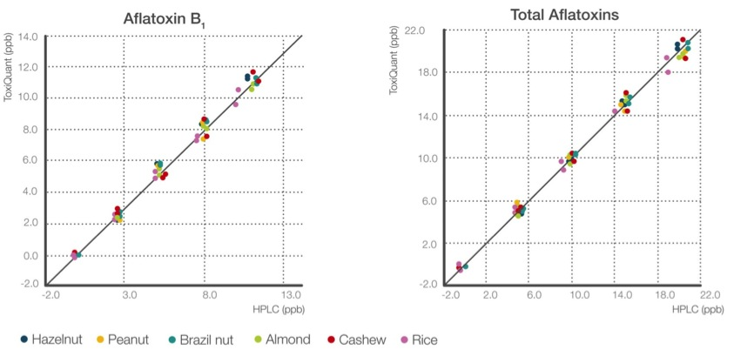
Highly accurate results obtained when ToxiQuant used to measure aflatoxins in a variety of foods, in excellent agreement with HPLC

Slide 29
Highly accurate results obtained when ToxiQuant used to measure aflatoxins in figs and ochratoxin A in dried vine fruit; in excellent agreement with HPLC at EU regulatory levels
Aflatoxins in Figs
Ochratoxin A in dried vine fruit
ToxiQuant (ppb)
ToxiQuant (ppb)
HPLC (ppb)
HPLC (ppb)

Slide 30
Limit of Detection (LOD) and Limit of Quantification (LOQ) are well below EU regulatory levels: e.g. aflatoxins in ready to eat groundnuts
(ppb) | LOD | LOQ | EU limit
Aflatoxin B₁ | 0.08 | 0.26 | 2.0
Total aflatoxins | 0.30 | 1.00 | 4.0

Slide 31
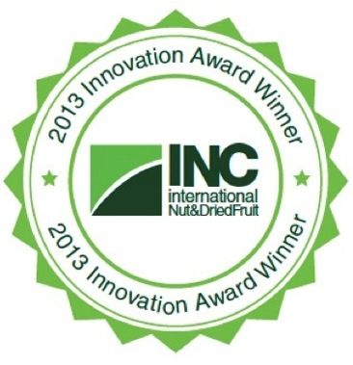
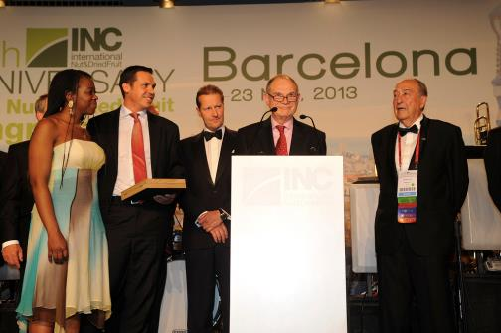
ToxiMet received the INC Innovation Award 2013, placing it as the technology of choice for the nut & dried fruit industry
INC congress, May 21st – 23rd 2013, Barcelona
1,100 delegates from 65 countries

Slide 32
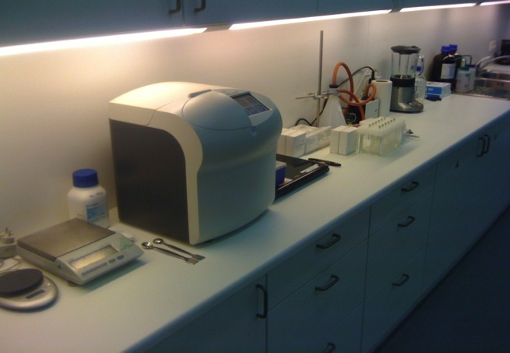
The ToxiMet System can be installed in a warehouse, processing plant, or other basic facility, in less than 1h, using very little space

Slide 33


ToxiQuant instruments are now present in five continents, and have received excellent customer feedback
  “Working with HPLC is difficult, time-consuming and also very expensive. The ToxiQuant system, being very fast and easy to use has completely changed the way we work. From making the slurry to getting the results takes 40 minutes which is very helpful in allowing us to make decisions quickly. This has, in-turn, had a significant effect on storage and shipping times. The cost saving is realised across the whole business.”
Elham Farajpour, Quality Control Manager, Cap Kerman
  “We undertook extensive tests with ToxiQuant to ensure that results were in line with HPLC testing. Given the accuracy, simplicity and the speed of response we are very happy with the new system. It also means that we no longer have to factor in time for the external testing of samples when supplying our buyers so deliveries can be made more quickly.”
Li Thi Kim Hue, Purchase & Quality Manager, Olam Vietnam

Slide 34
THE TOXIMET SYSTEM IN INDIA, CHINA & VIETNAM…

Slide 35
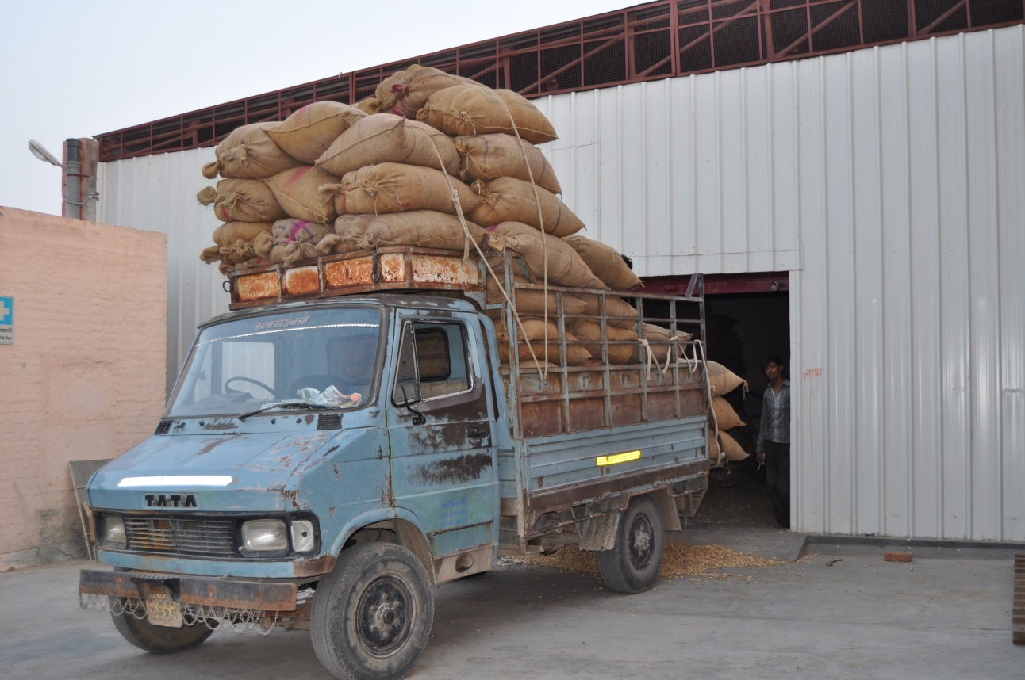
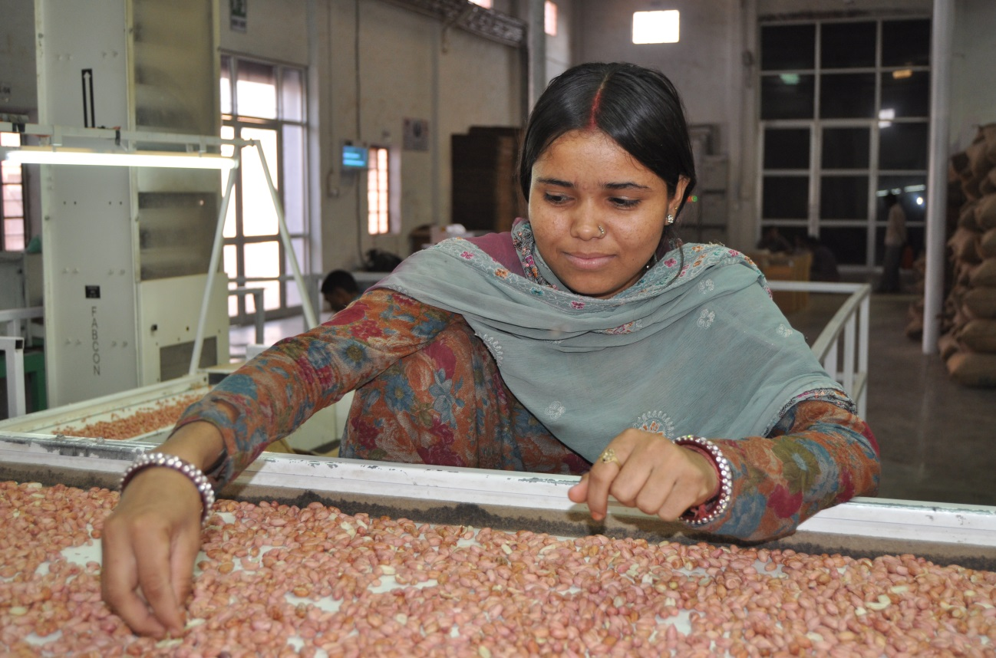
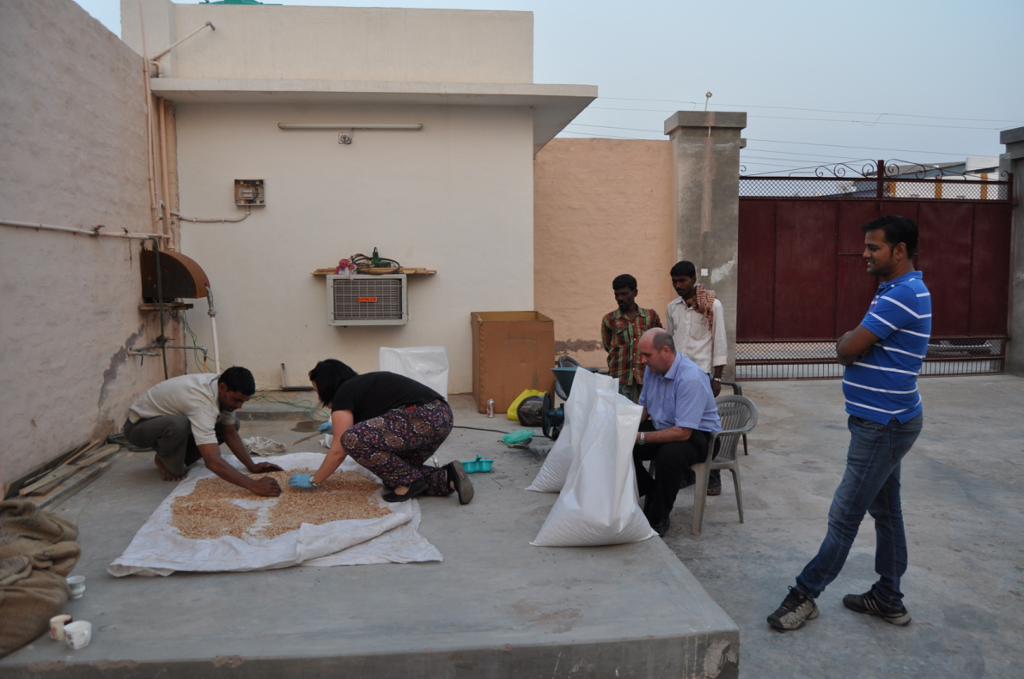
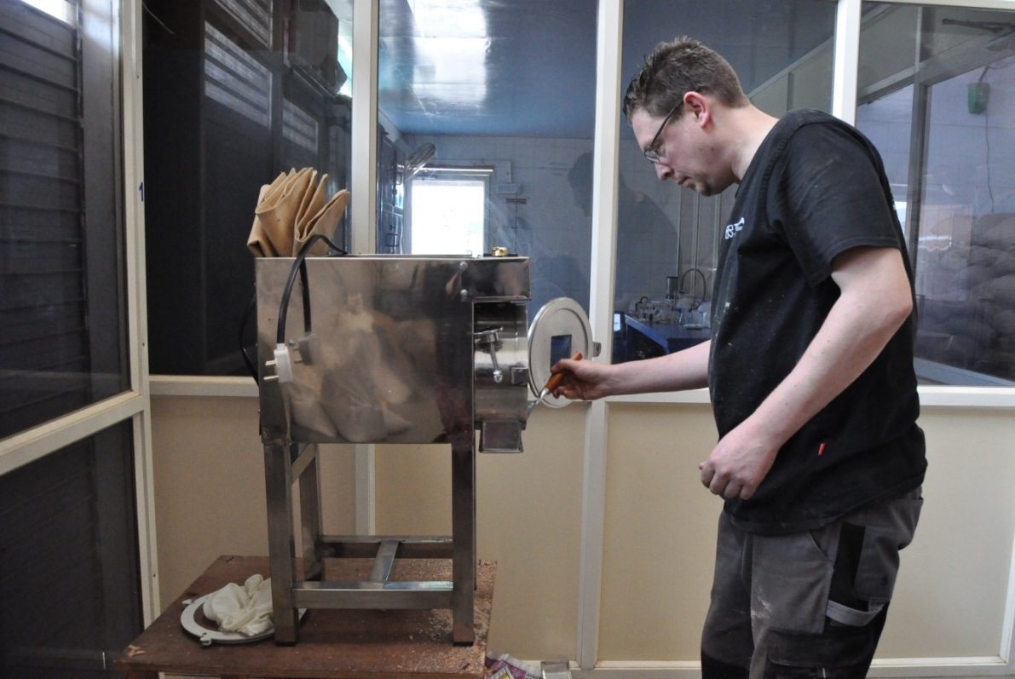
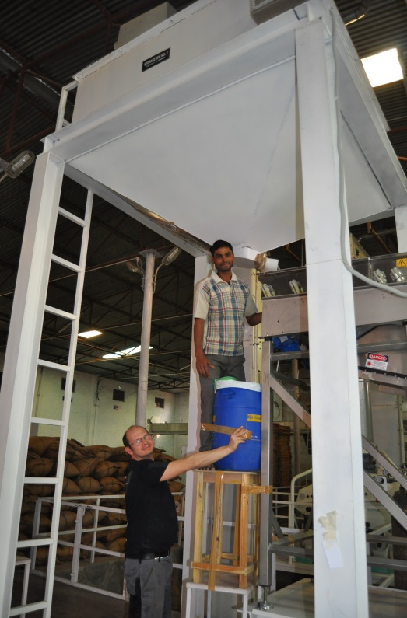
India – Sampling & sample preparation
prior to aflatoxin testing

Slide 36
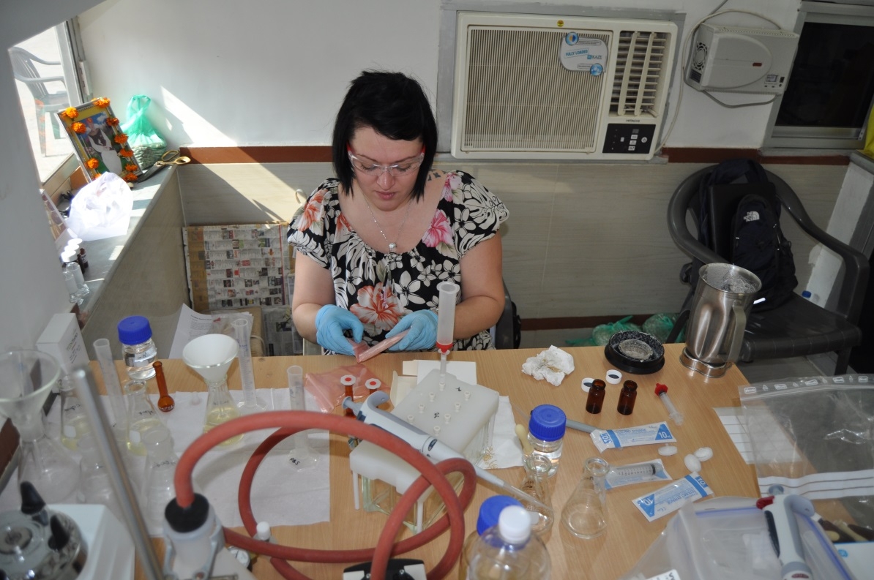
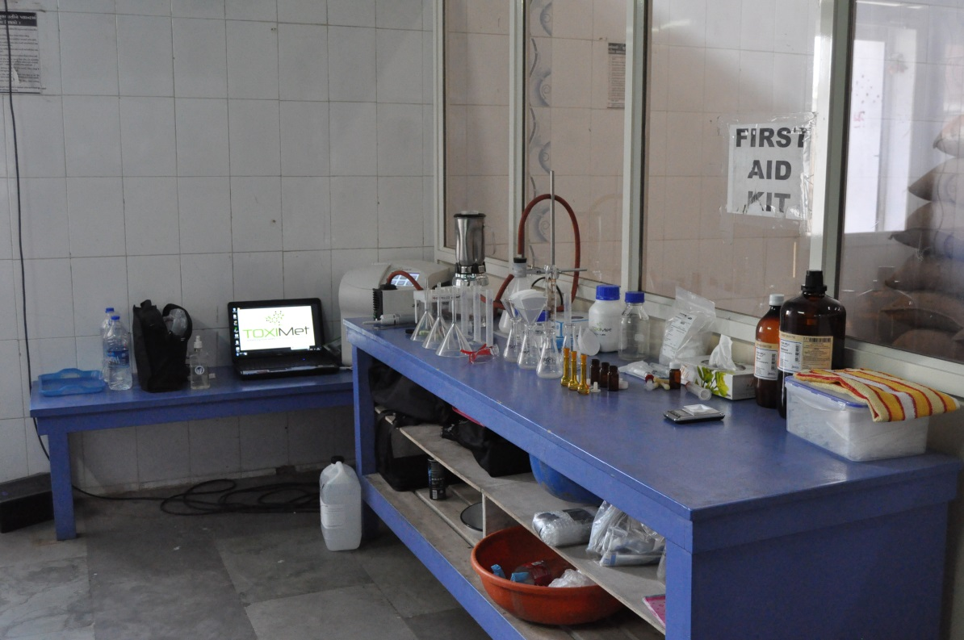
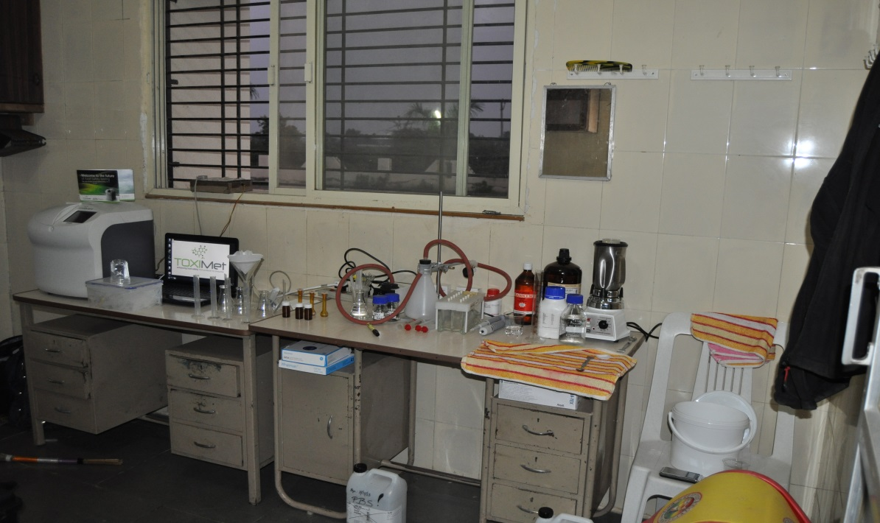
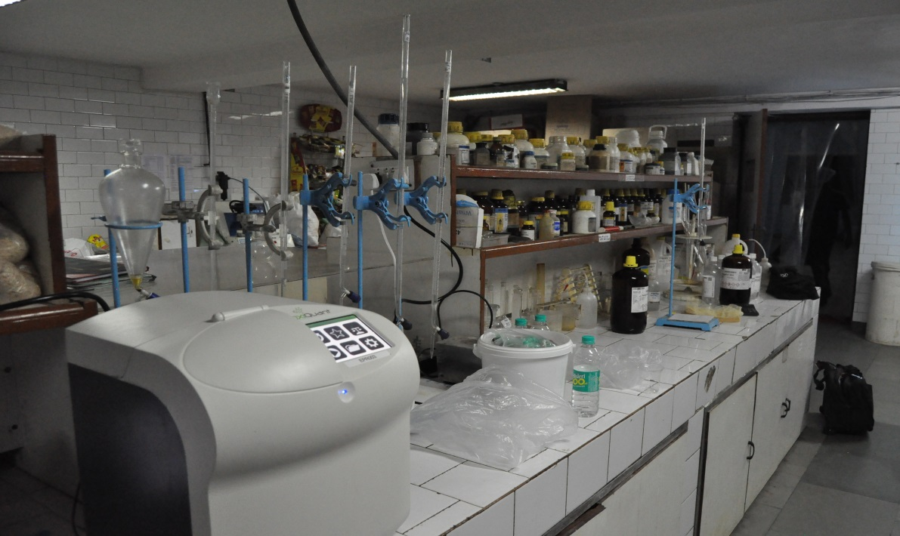
The ToxiMet System in India

Slide 37
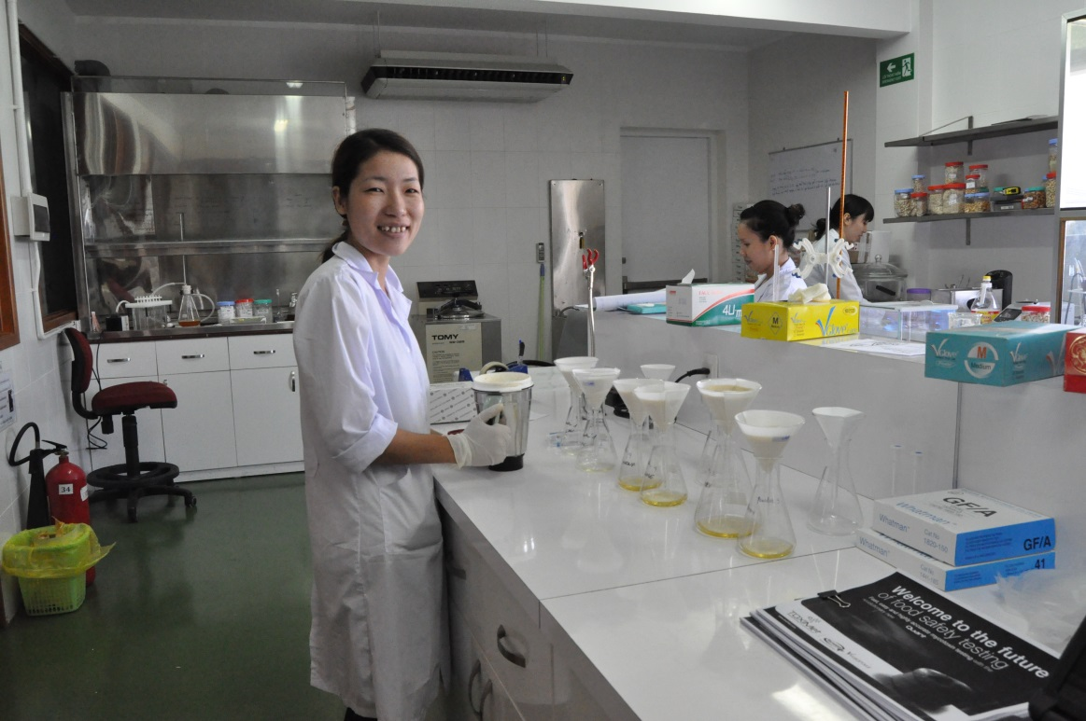
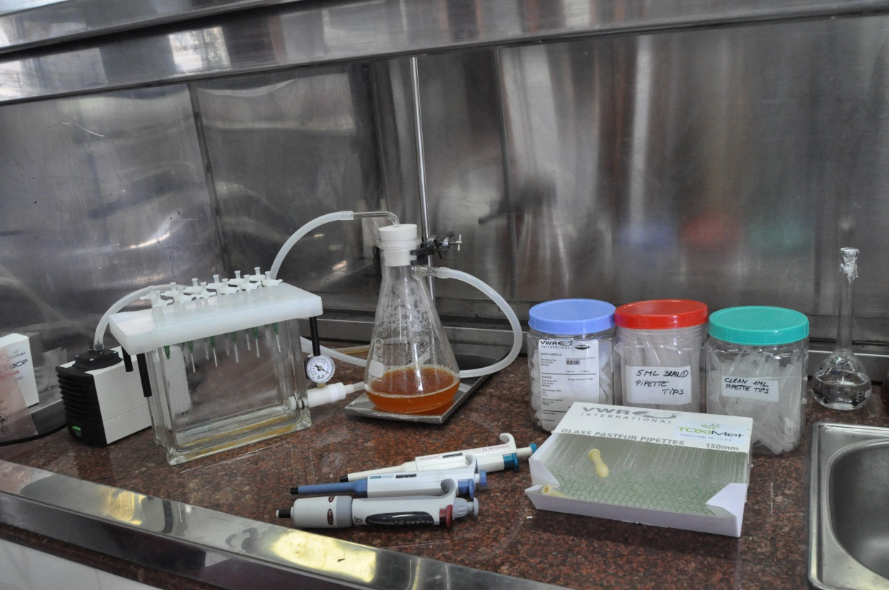
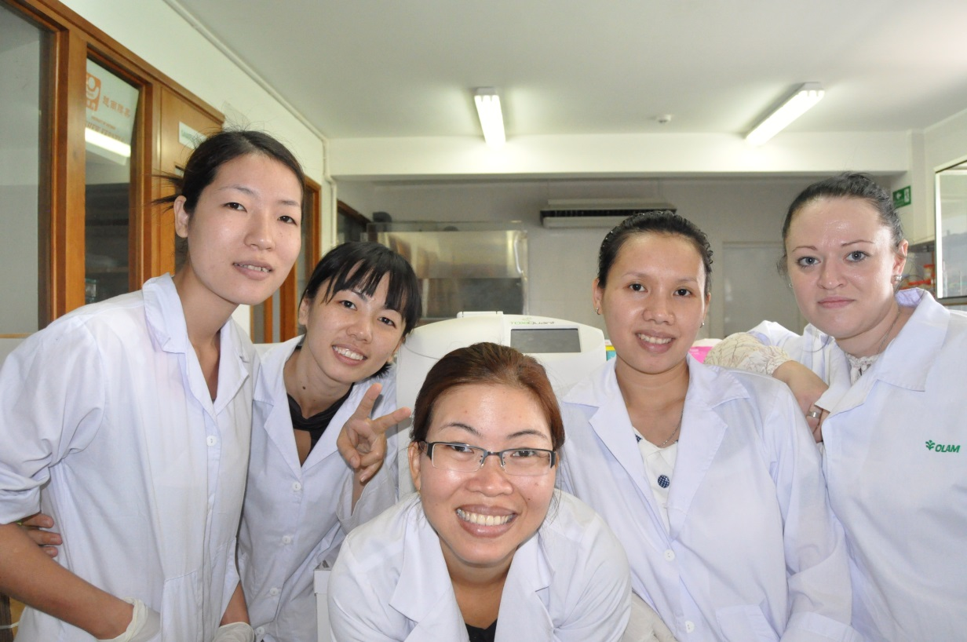

The ToxiMet System in Vietnam

Slide 38






The ToxiMet System in China

Slide 39

Thank you for your kind attention! raycokerconsulting@gmail.com www.toximet.com

